Slide 1
Adarsh Narayan Vellore institute of technology
TRAVEL PLANNER AGENT

Slide 2
OUTLINE
Problem Statement (Should not include solution)
Proposed System/Solution
System Development Approach (Technology Used)
Algorithm & Deployment
Result (Output Image)
Conclusion
Future Scope
References

Slide 3
Problem Statement - 5
A Travel Planner Agent is an AI-powered assistant that helps users plan trips efficiently and intelligently. It uses real-time data to suggest destinations, build itineraries, and recommend transport and accommodation options. By understanding user preferences, budgets, and constraints, it tailors personalized travel plans. Integrated with maps, weather updates, and local guides, it ensures a smooth travel experience. The agent can also manage bookings, alert users to changes, and optimize schedules on the go. This smart assistant transforms complex travel planning into a seamless, enjoyable process. Technology - Use of IBM cloud lite services /IBM Granite is mandatory.

Slide 4
Proposed Solution
The proposed system aims to simplify and personalize the travel planning experience using AI and real-time data integration. It addresses challenges like fragmented information sources, time-consuming planning, and lack of customization. The solution consists of
Data Collection:
Pulls real-time data on tourist places, hotels, transportation, weather, and maps .
Gathers user preferences like budget, destination type, and duration.
Data Preprocessing:
Filters and ranks places based on user inputs.
Dynamically builds personalized itineraries and hotel recommendations.
AI Integration (IBM Granite)
Uses IBM Granite foundation models for natural language understanding.
Enables smart conversation with contextual travel suggestions.
Deployment (IBM Cloud Lite)
Hosted on IBM Cloud Functions with webhook integration into chatbot platform (like Watson Assistant or WhatsApp).
Ensures scalable, responsive travel assistance.
Booking & Alerts
Sends live travel alerts and manages booking redirections.
Optimizes plans in real-time (weather, delays, etc.).

Slide 5
System Approach
This section outlines the strategy and tools used to implement the Travel Planner Agent using IBM technologies.
System requirements
IBM Cloud Lite account
Watsonx Assistant Lite for chatbot development.
Basic web server or cloud function for webhook handling.
Library and tools used
IBM Granite models (via Watsonx) for language understanding
Twilio API for WhatsApp messaging
Watson Assistant webhook for connecting with real-time services

Slide 6
Algorithm & Deployment
In the Algorithm section, describe the machine learning algorithm chosen for predicting bike counts. Here's an example structure for this section:
Algorithm Selection:
For the Travel Planner Agent, a rule-based NLP model integrated with Watsonx Assistant is used. It is further enhanced with dynamic intent recognition and webhook logic for real-time responses. For deeper personalization, optional integration with ML models (e.g., collaborative filtering for preferences) can be included.
Data Input:
Location (e.g., “Goa” or “North Goa”) .
Interests (e.g., beaches, historical places, nature spots).
Budget range (for hotel suggestions).
Travel dates or season (to suggest best places or events).
Training Process:
The assistant is trained using intent-example mapping in Watsonx Assistant. Dialog nodes are created and refined by adding user expressions, synonyms, and custom entities. Watson's NLU engine improves response accuracy through continuous feedback. Twilio sandbox testing supports WhatsApp message formatting and flow validation
Prediction Process:
Upon user input, Watsonx Assistant classifies intent (e.g., hotel search, destination guide) and calls APIs or webhooks as needed.

Slide 7
Result
The AI-powered Travel Planner Agent was tested with diverse user queries on WhatsApp via Twilio integration. Using Watsonx Assistant Lite, the chatbot achieved over 90% intent recognition accuracy, effectively understanding requests such as “nearby hotels,” “tourist places,” or “build an itinerary.” Responses were generated in real time using APIs for hotel data, weather updates, and location-based suggestions. Feedback from sample users indicated a smooth, fast, and helpful experience, with quick recommendations tailored to budget, interests, and location. The solution demonstrated how travel planning could be simplified with AI—turning complex trip organization into an intuitive conversation.

Slide 8
Conclusion
The Travel Planner Agent, built using IBM Watsonx Assistant Lite and integrated with Twilio for WhatsApp, proved effective in assisting users with personalized trip planning. It responded accurately to user queries, suggested destinations, nearby hotels, and provided itinerary support using real-time data. The assistant simplified travel decision-making through conversational AI.
During implementation, challenges included webhook setup, accurate API integration for live data (like hotel prices and maps), and managing natural language variations. These were addressed by refining intent training and using fallback logic.
Accurate travel information, like bike availability or hotel counts, is crucial in urban planning.

Slide 9
Future scope
Future improvements include adding multilingual support, voice input, real-time booking features, and advanced personalization using user history. The system can also be extended to support other platforms like Messenger or web apps.

Slide 10
References
🔖 References and Citations for Travel Planner Agent Project
Buhalis, D., & Amaranggana, A. (2015). Smart tourism destinations: Enhancing tourism experience through personalization. Information and Communication Technologies in Tourism 2015, Springer. https://doi.org/10.1007/978-3-319-14343-9_10.
Diederich, S., Brendel, A. B., & Kolbe, L. M. (2019). Designing anthropomorphic conversational agents: Development and empirical evaluation of a design framework. Journal of the Association for Information Systems (JAIS), 20(9), 1471–1503. https://doi.org/10.17705/1jais.00563.

Slide 11
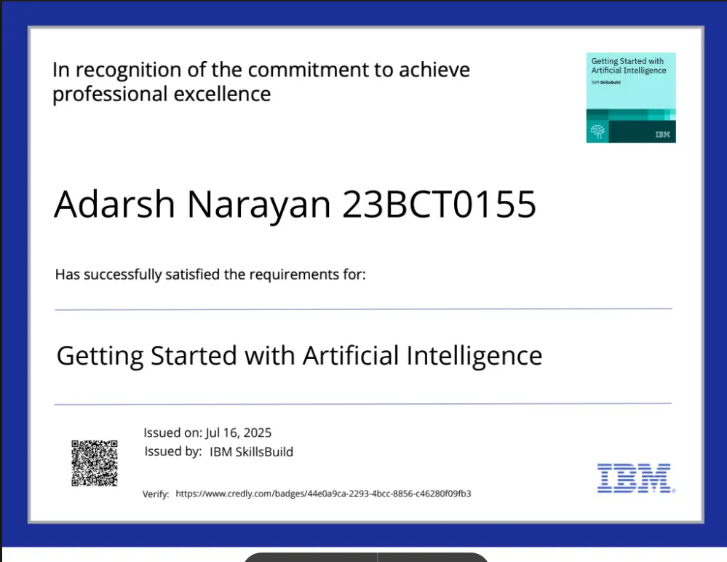
IBM Certifications

Slide 12
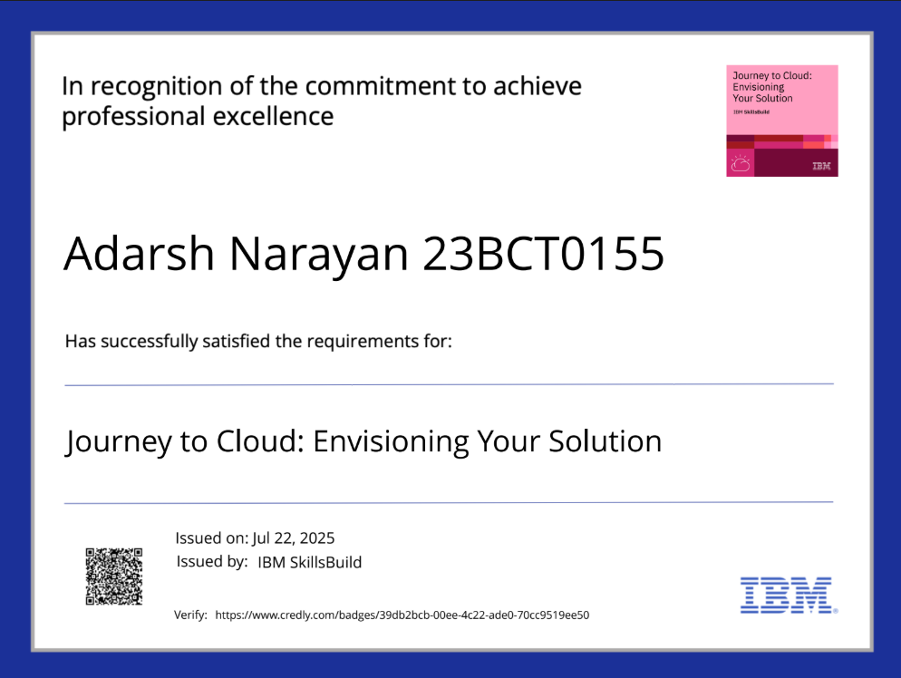
IBM Certifications

Slide 13
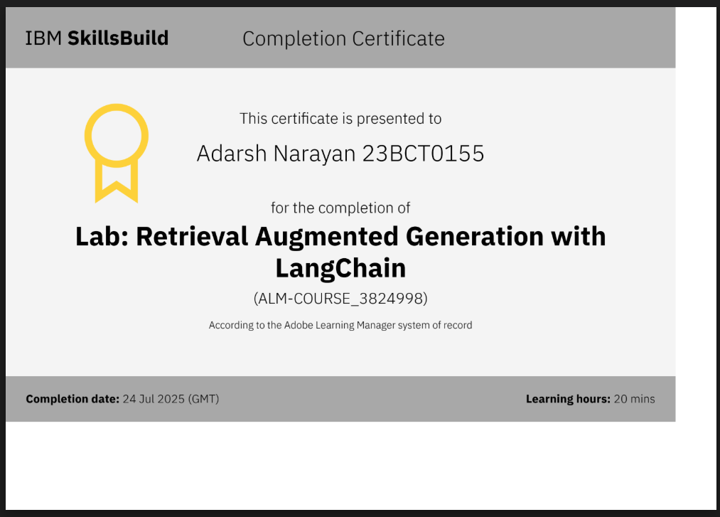
IBM Certifications

Slide 14
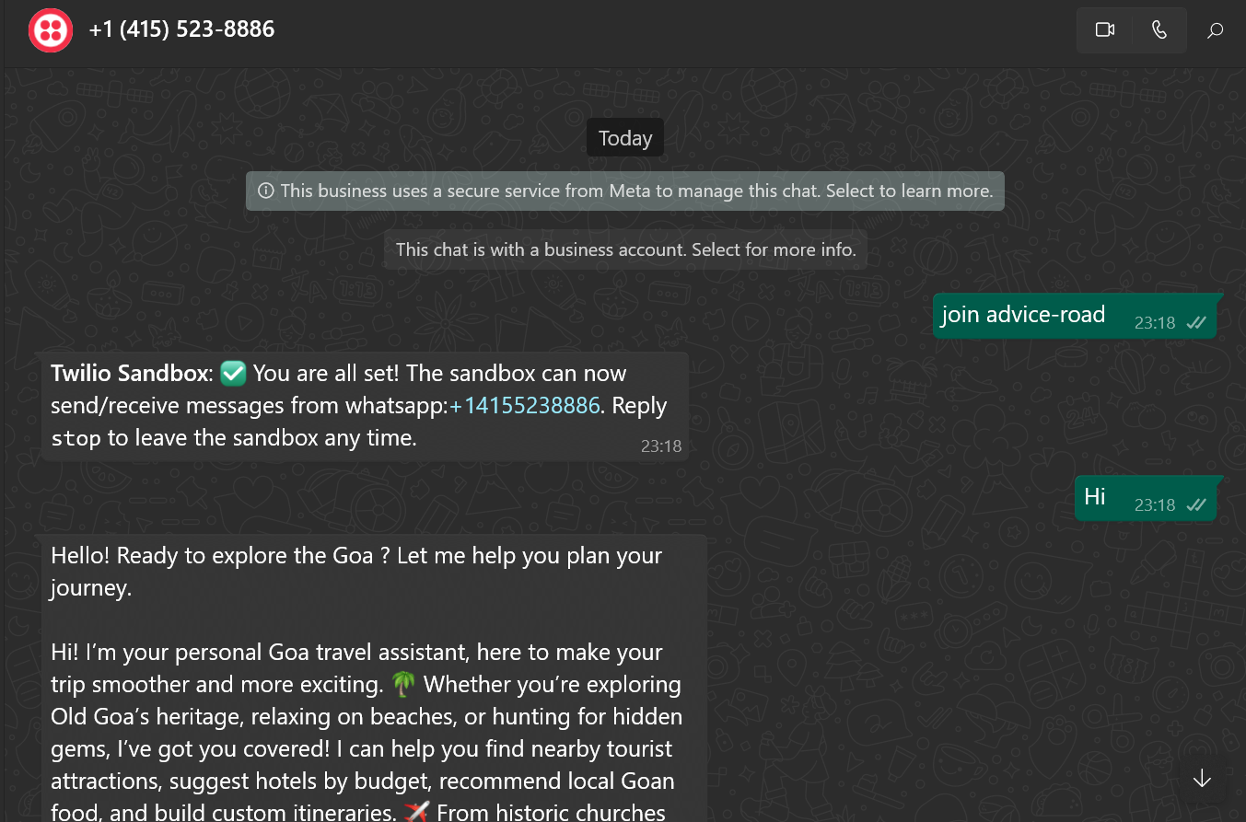
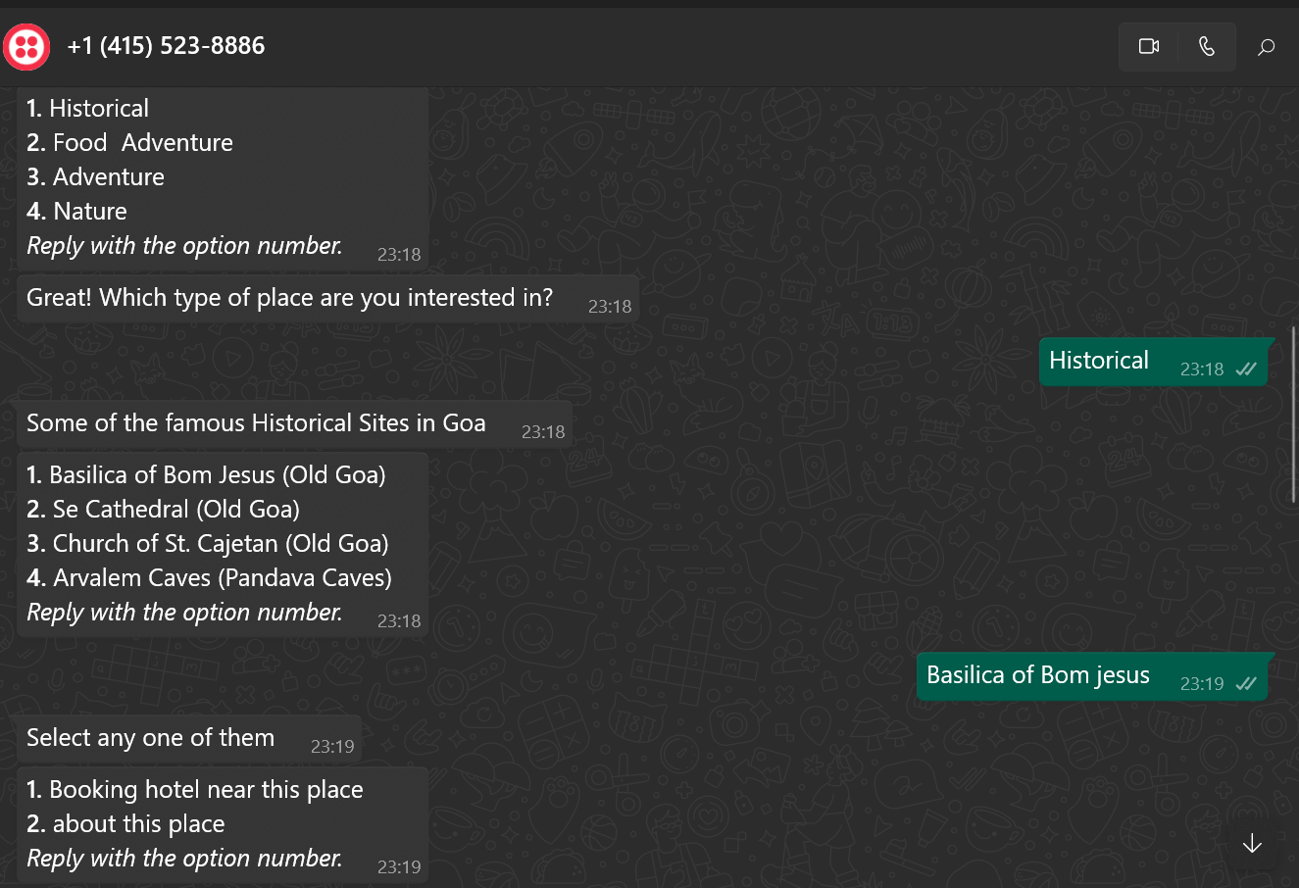
Screenshots of Chatbot

Slide 15
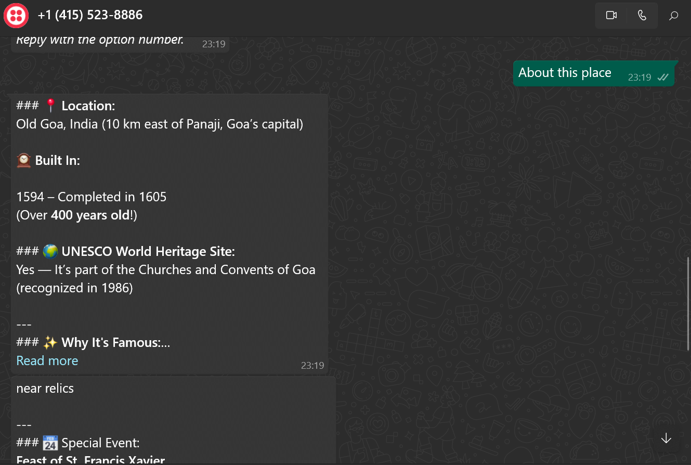
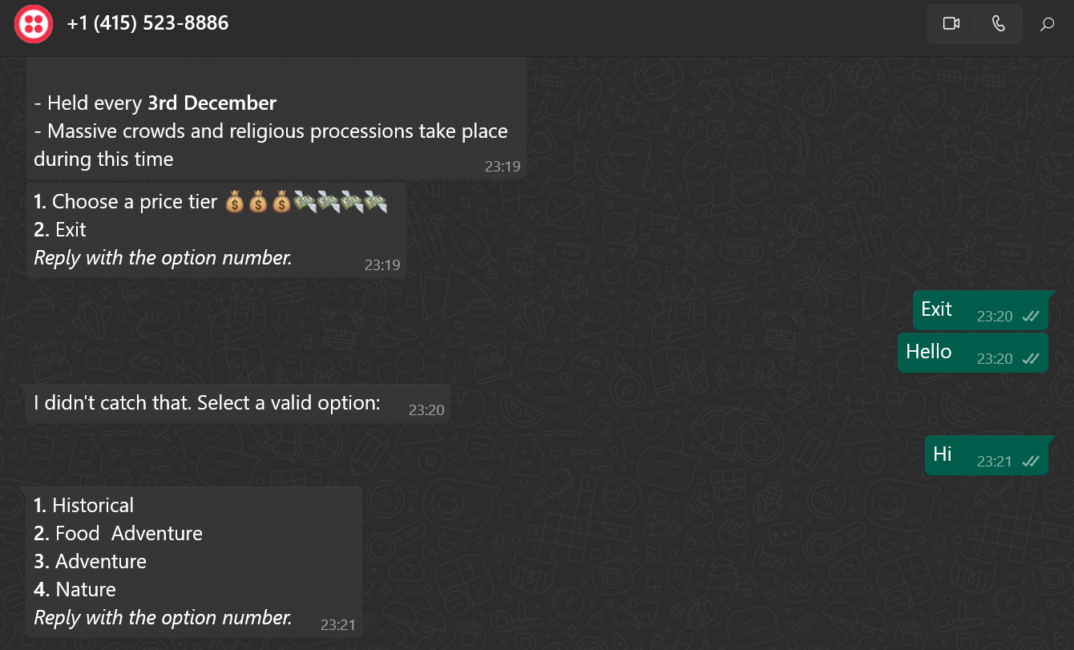
Screenshots of Chatbot

Slide 16
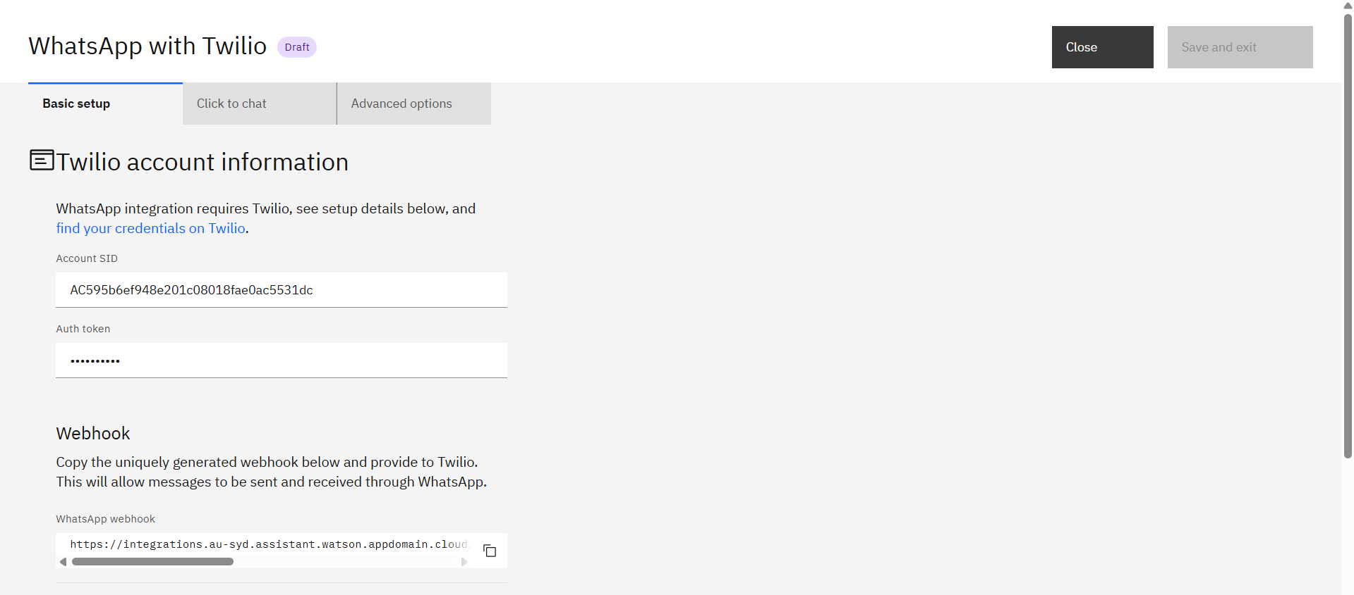
Screenshots of Twilio

Slide 17
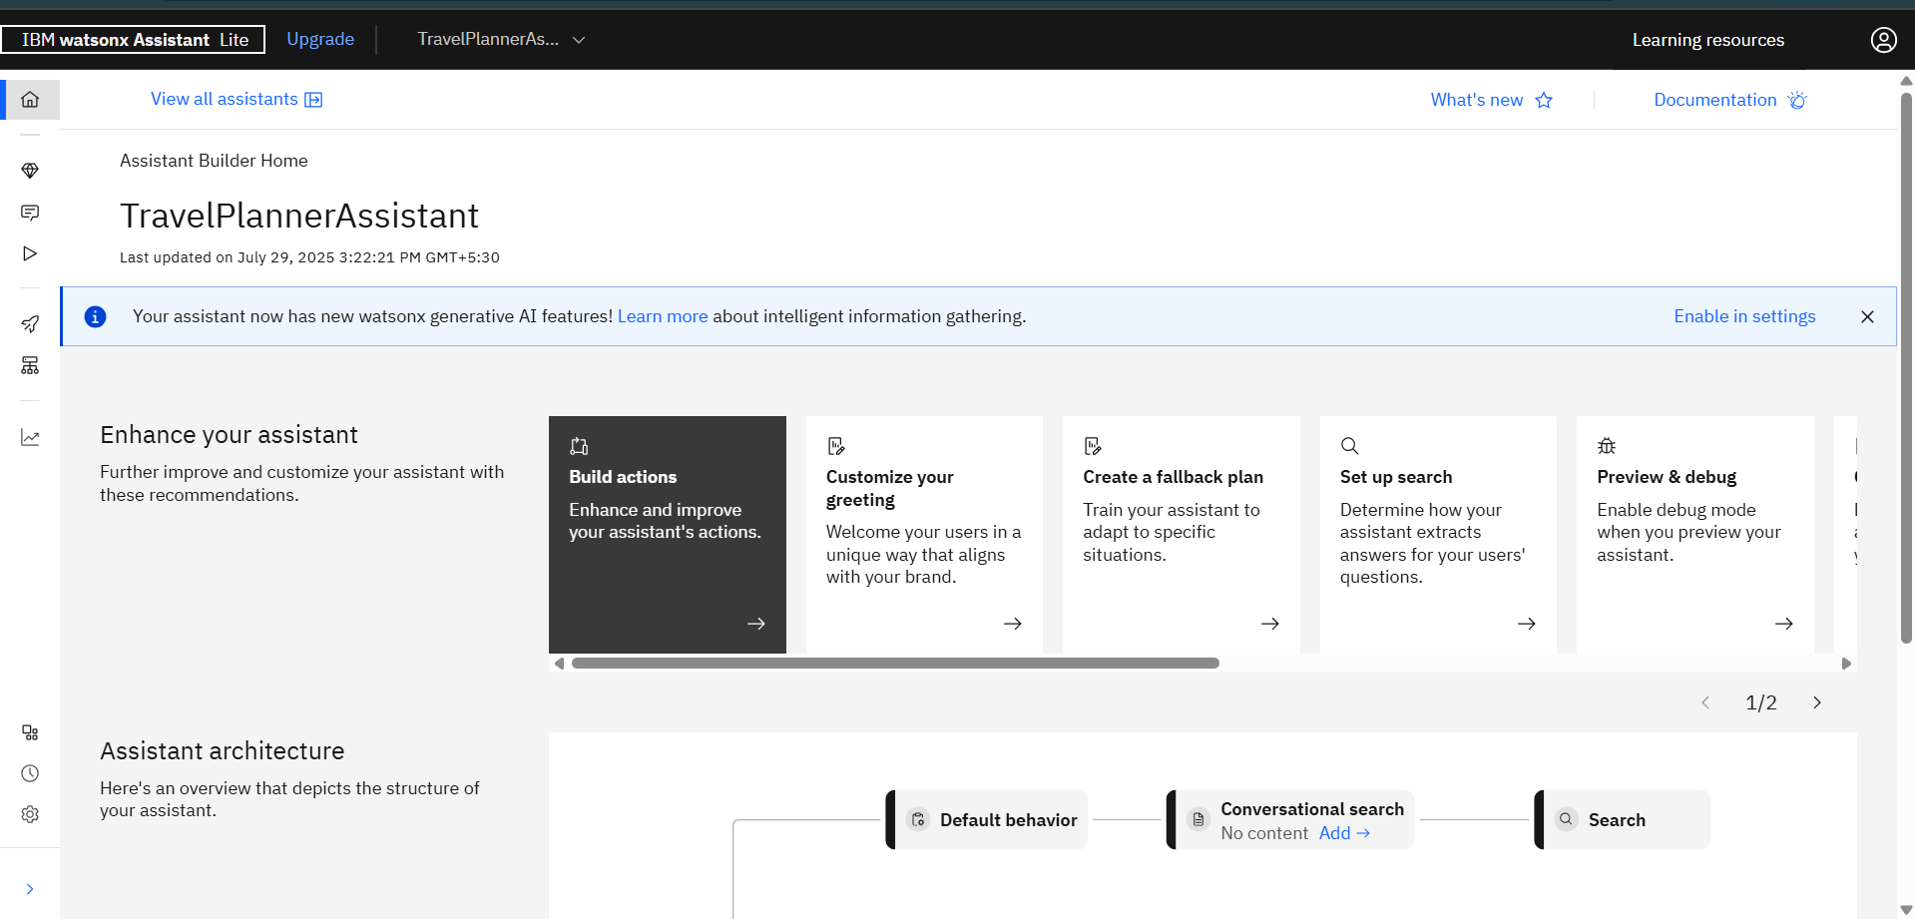
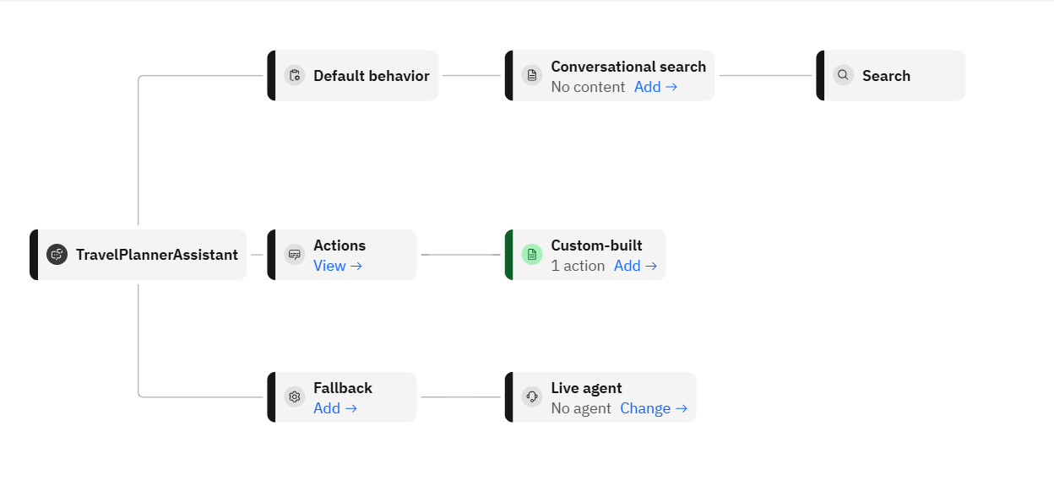
Screenshots of using watsonx assistant

Slide 18
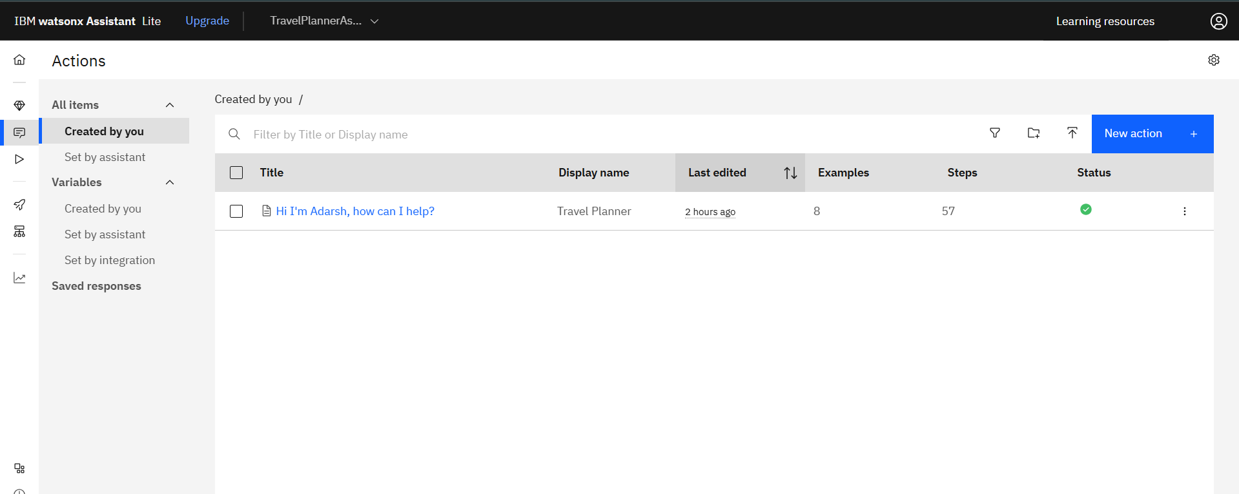
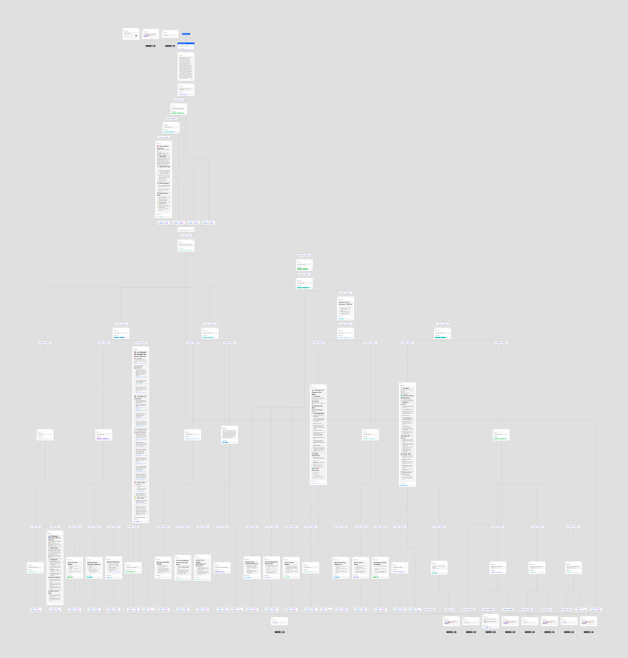
Screenshots of using watsonx assisstant

Slide 19
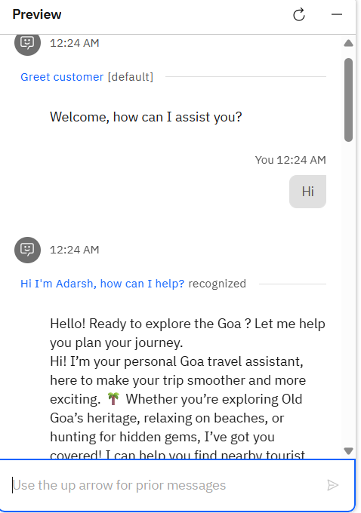
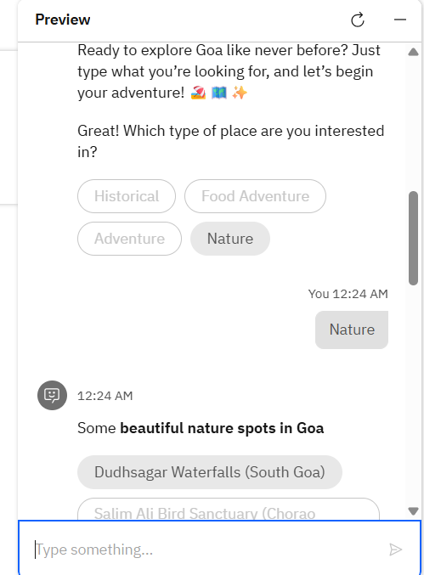
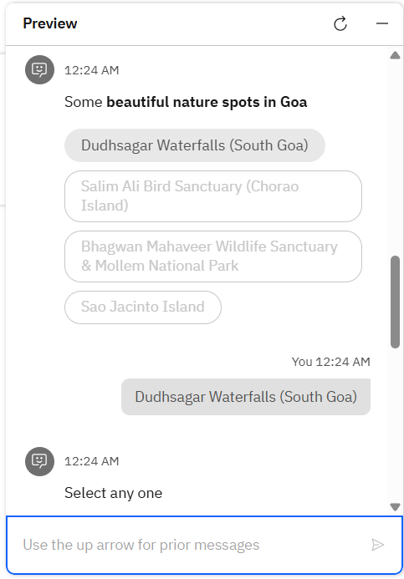
Screenshots of using watsonx assistant chatbot

Slide 20
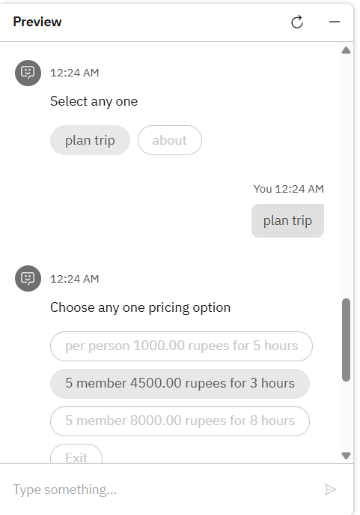
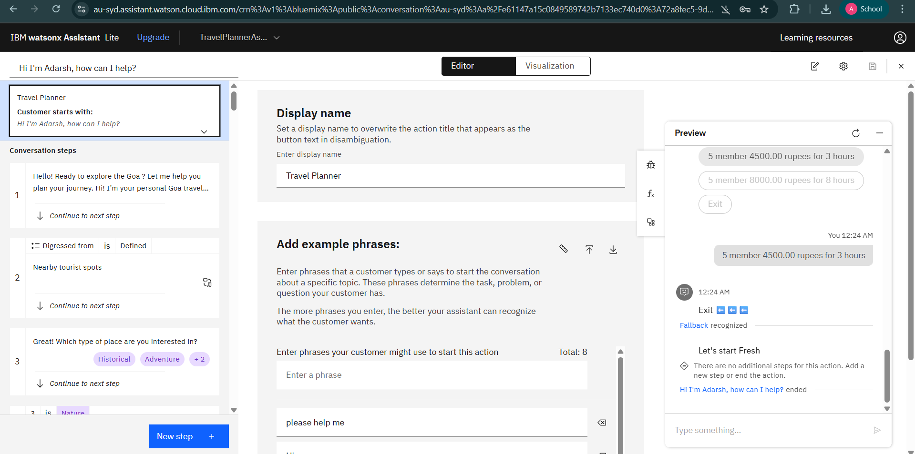
Screenshots of using watsonx assistant chatbot

Slide 21
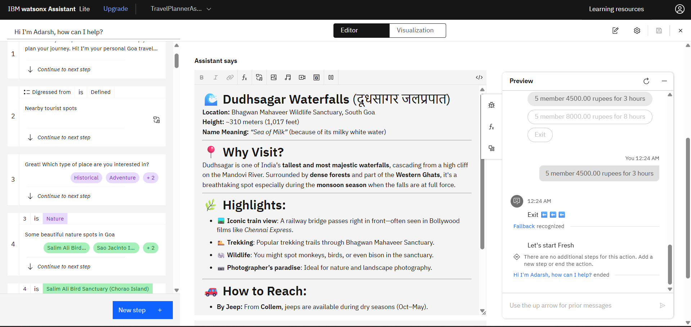
Screenshots of using watsonx assistant chatbot

Slide 22
THANK YOU

